Slide 1
CUBC Inventory System

Slide 2
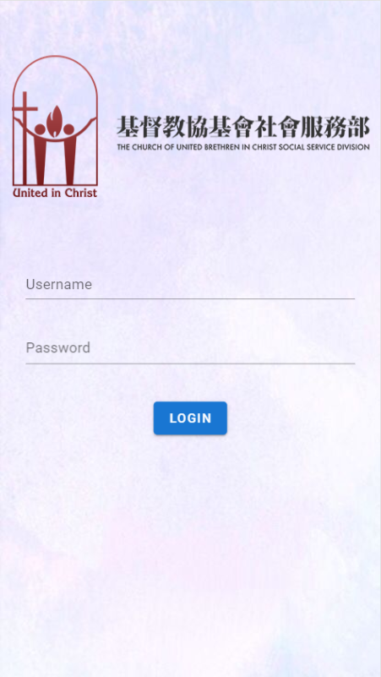
Login Page
Two User Type:
Admin
Normal Staff

Slide 3
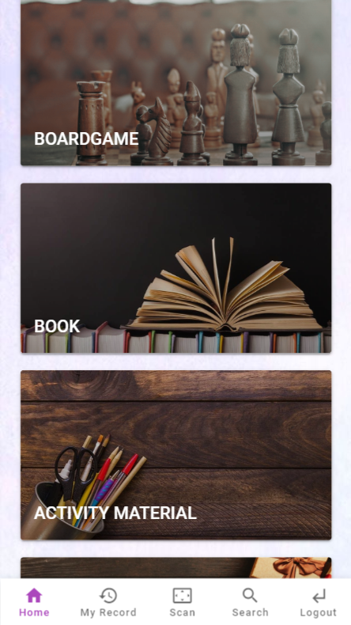
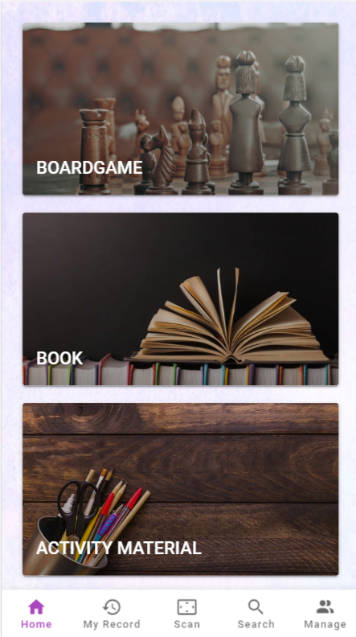
Home Page
Four Main Categories
BoardGame
Book
Activity Material
Present

Slide 4
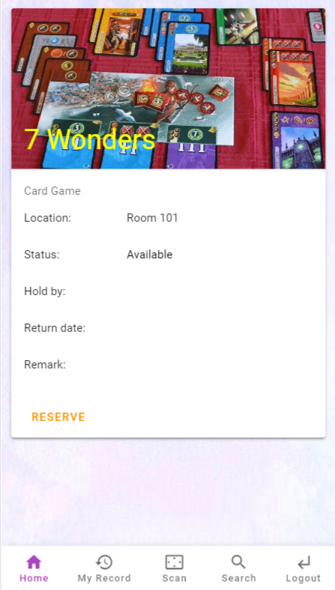
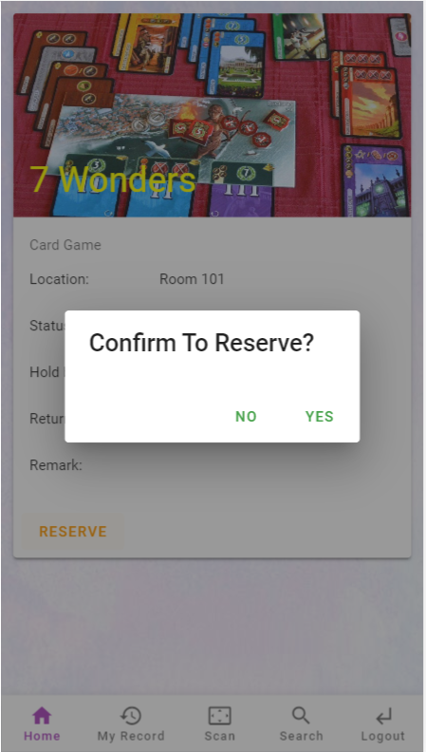
Item Detail Boardgame & Book
Show item information
Allow to make reservation if available

Slide 5
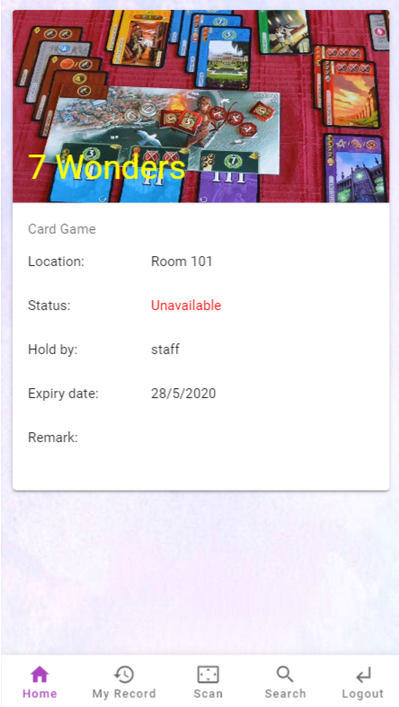
Item Detail Boardgame & Book
Unavailable to reservate if someone already borrowed it.

Slide 6
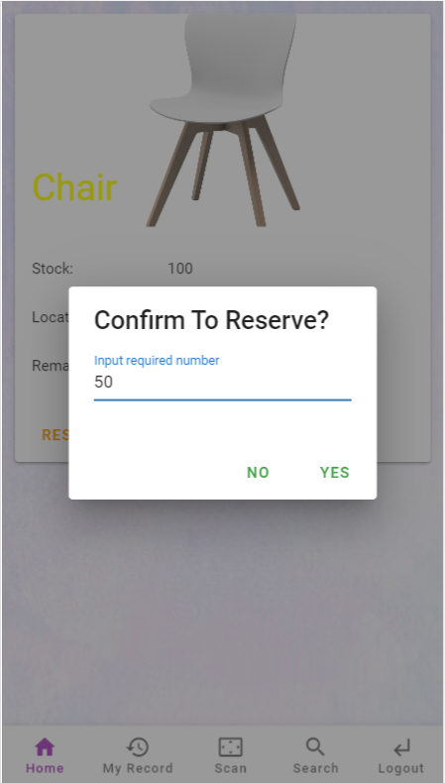
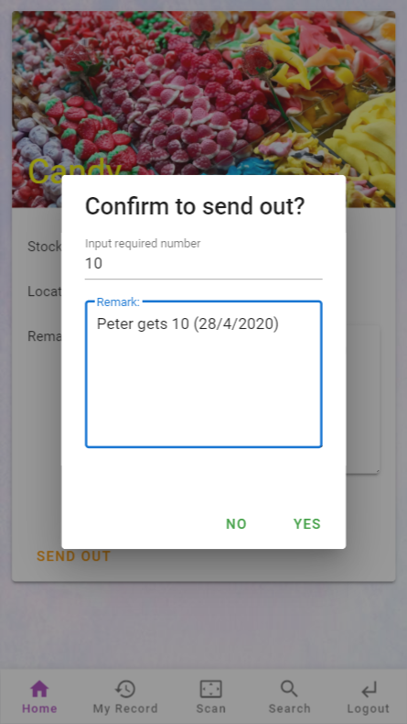
Item Detail
Activity material & Present
Show item information
Allow to make reservation or send out if stock > 0

Slide 7
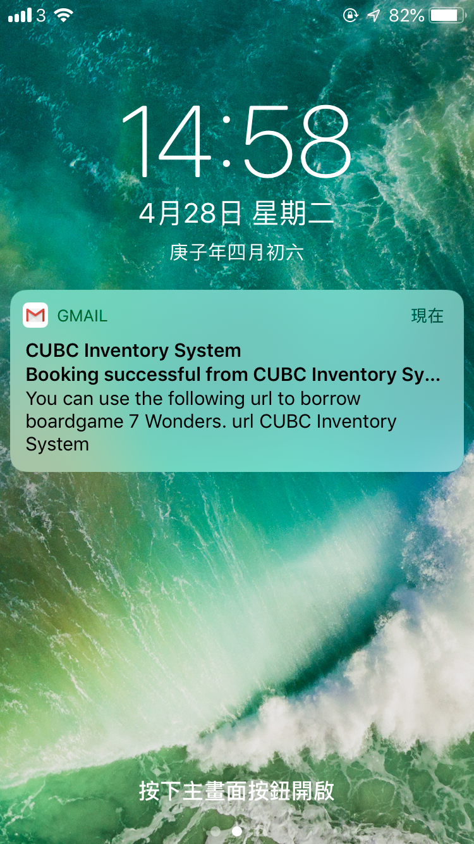
Confirmation Email
Receive a email with a link
Open the link to complete borrowing

Slide 8
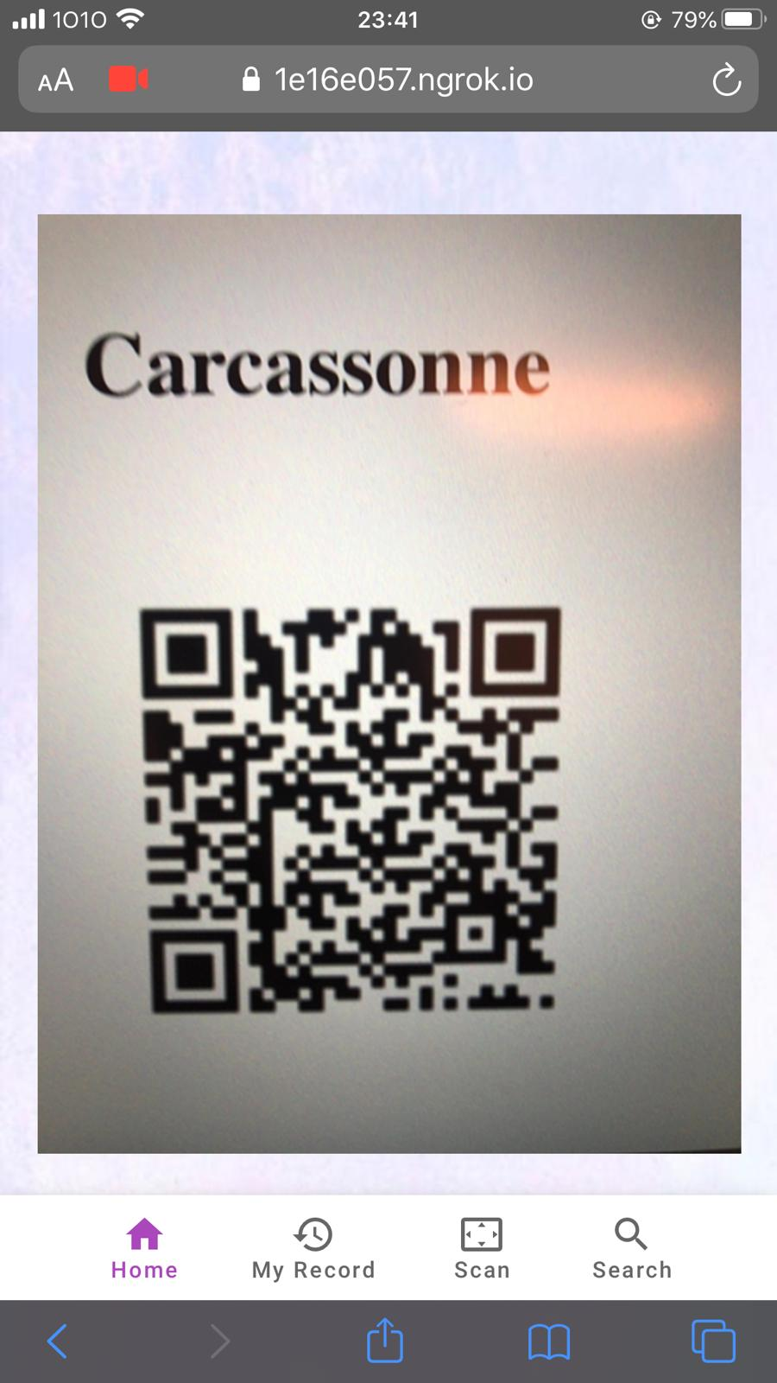
Scanner Page Borrow Item
Open the link in confirmation email and it redirects users to a web page
Users can scan the item’s QR code by using mobile camera
Click the SUBMIT button
The specify item is successfully borrowed

Slide 9
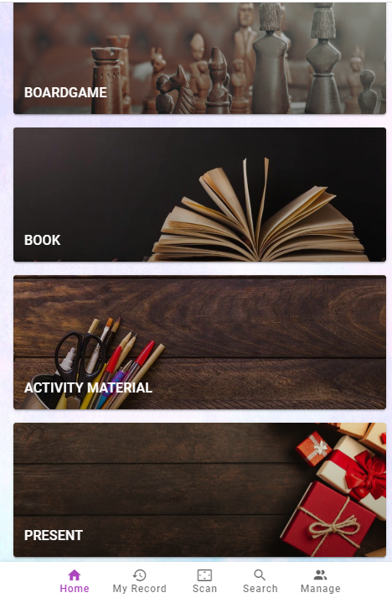
Scanner Page
Return Item
Click the scan button then scan the item’s QR code
Upload the latest photo of item
Upload the remark of item
Click the SUBMIT button
The specify item is successfully returned

Slide 10
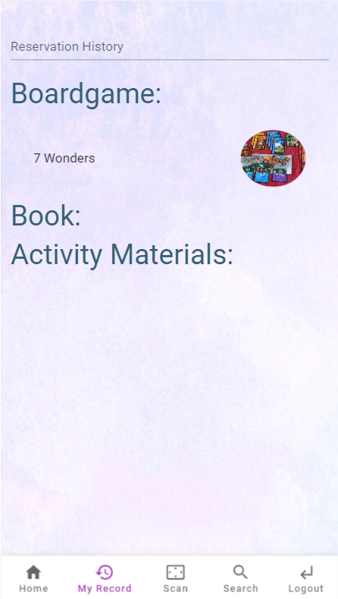
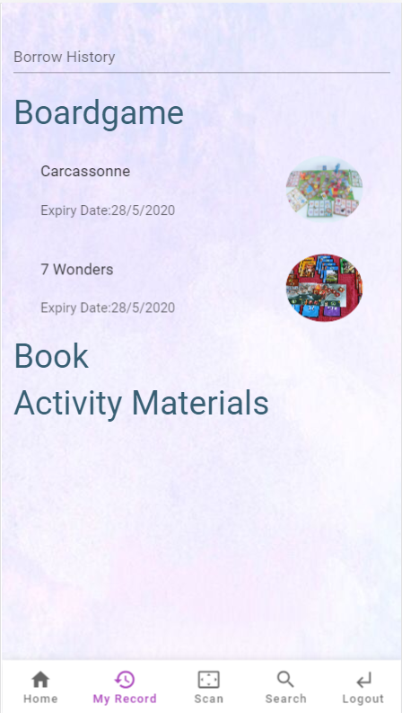
Activity History
List reservation and borrowing history

Slide 11
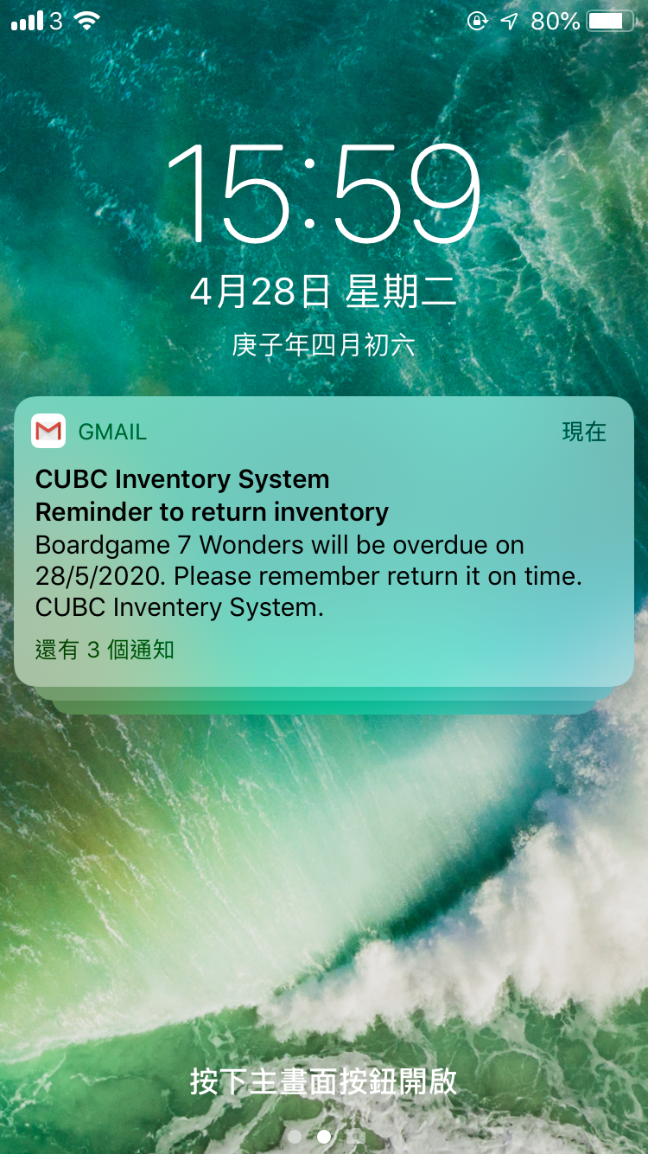
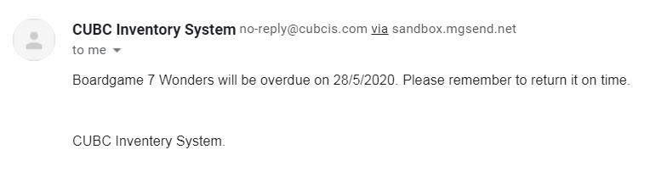
Reminder email
To remind user to return item 3 days before the expiry date

Slide 12
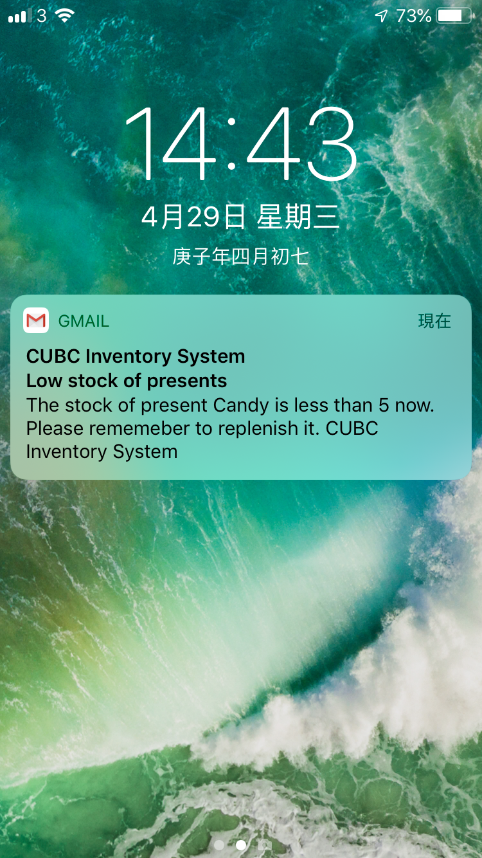
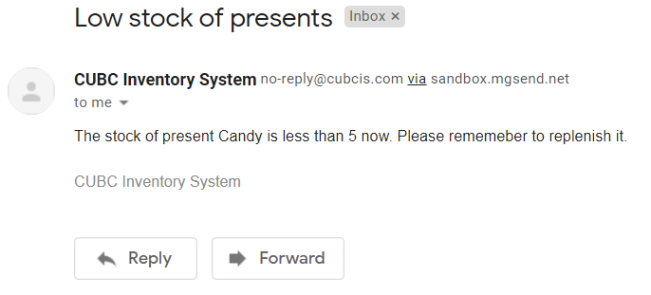
Reminder email
Inform admin user there is going to a shortage of stock

Slide 13
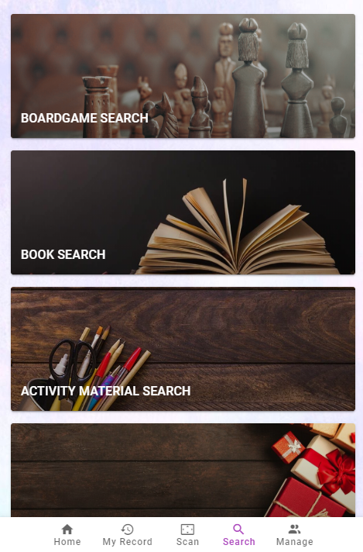
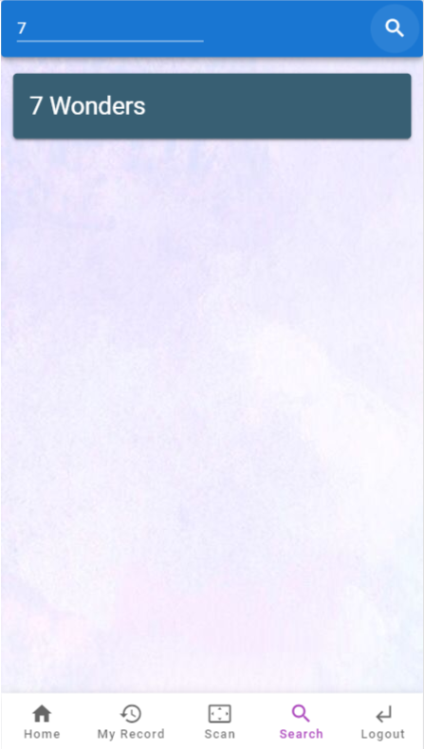
Search Page
User can search specific item by keywords ( Item Name)
Base on the keywords, search page will show the similar items
User can click the specific item to see the item detail and make booking

Slide 14
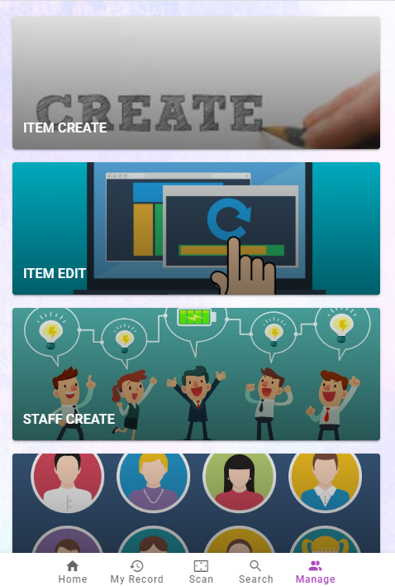
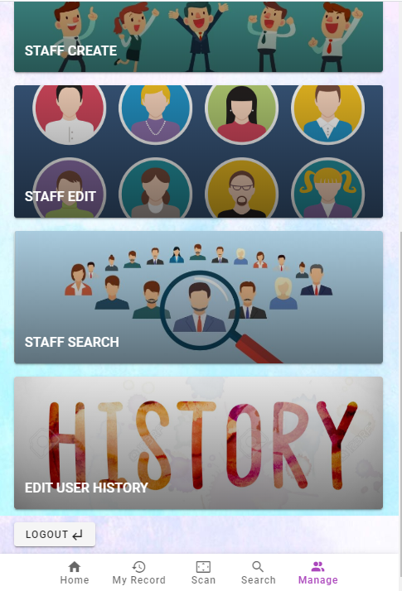
Admin Manage
Admin can create, edit and item or staff in the manage page

Slide 15
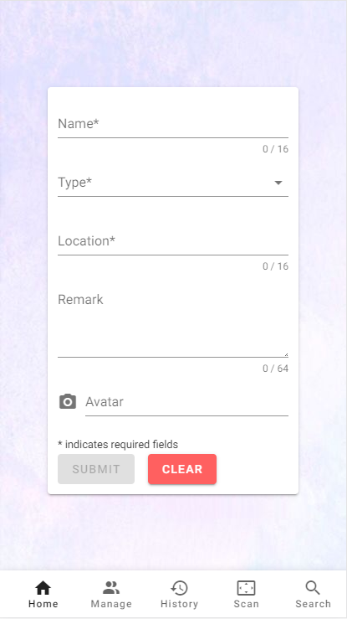
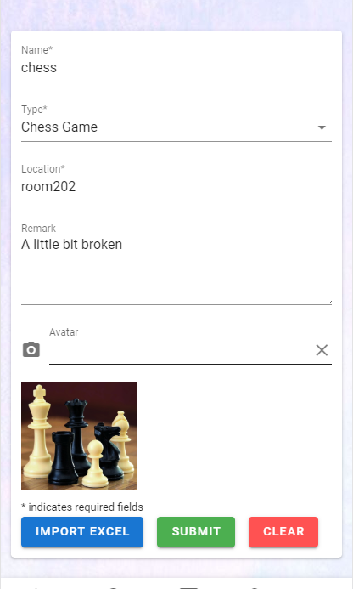
Item Create
Click submit button to create it.
If everything is correct, then click the “submit” button and the item has already been created.

Slide 16
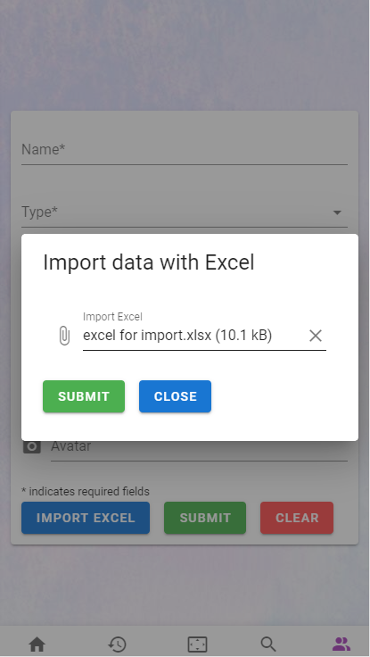
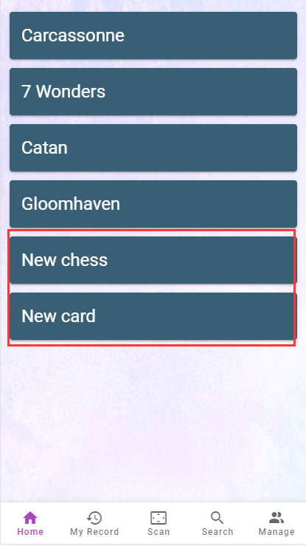
Item Create
Admin can also click “Import Excel” button for batch creation.
After uploading the excel file, click submit to create.

Slide 17
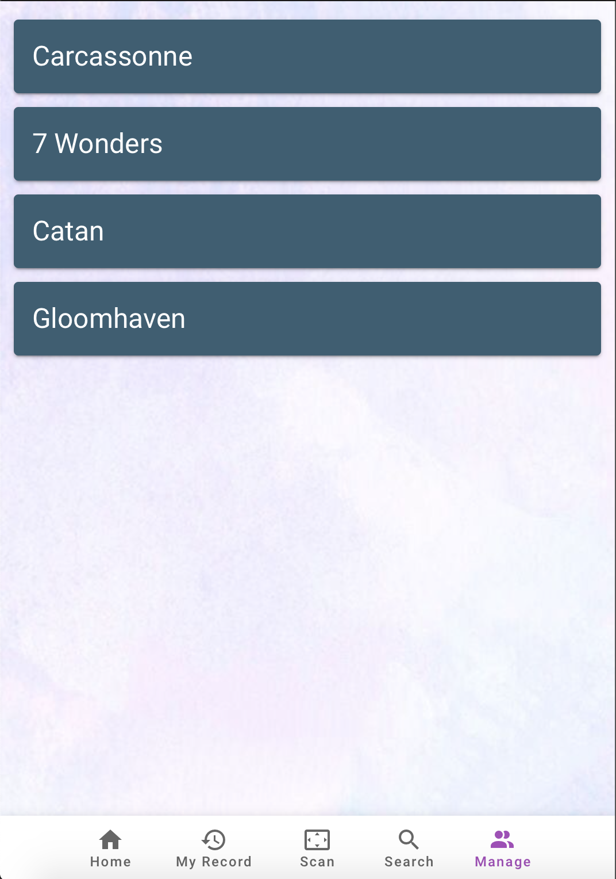
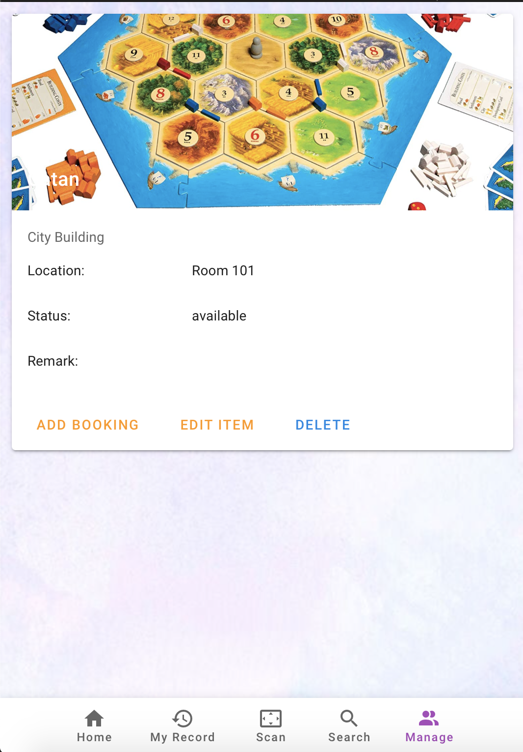
Item List and Detail
Admin can find the item list inside “item edit”
Item list shows the name of all items
Click on the name of the item, a detail page of that item will be shown

Slide 18
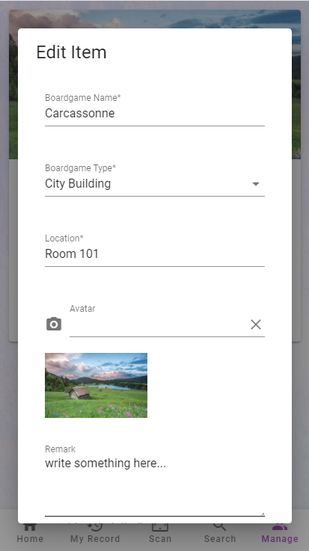
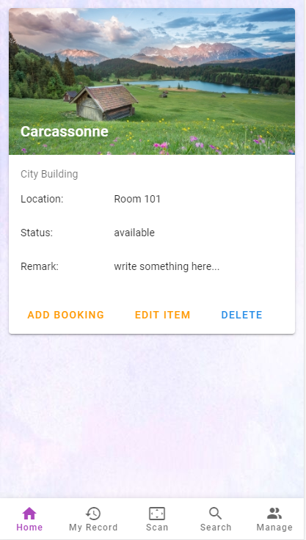
Item Edit
Admin can click the “edit item” button to open a dialog.
In this dialog, you can edit all the attributes you want.
After Admin click “Save” button, the updated detail page will be displayed.

Slide 19
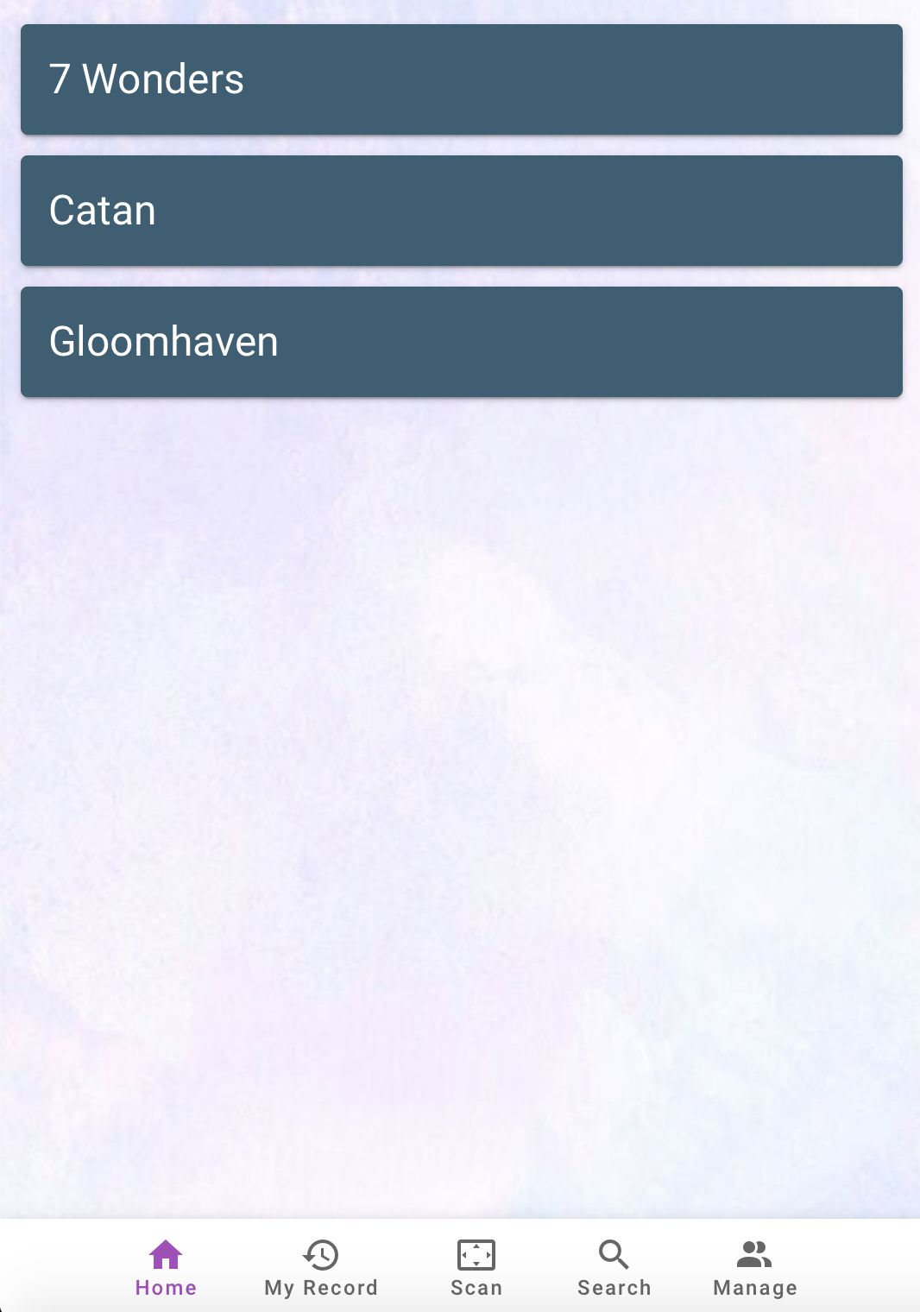
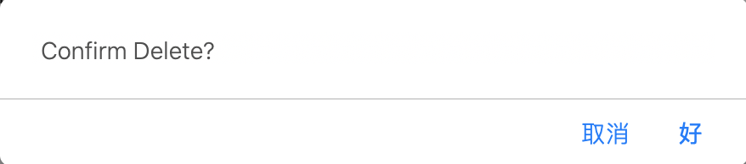
Item Delete
If admin want to remove the item, click the delete button in the item detail page
A confirm message will be show
After clicking the confirm message, unwanted item can be deleted
And the page will redirect to the item list
No
Yes

Slide 20
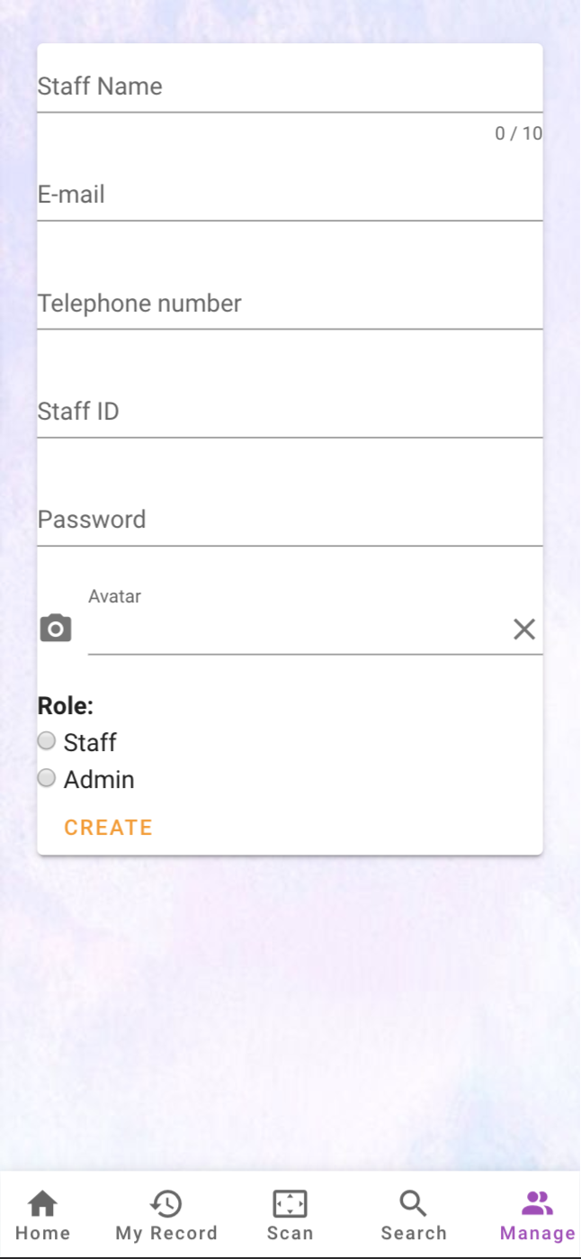
Staff Create
Admin can create staff account by entering the information of the new staff
Admin can set the password for the staff and choose the role of the created account

Slide 21
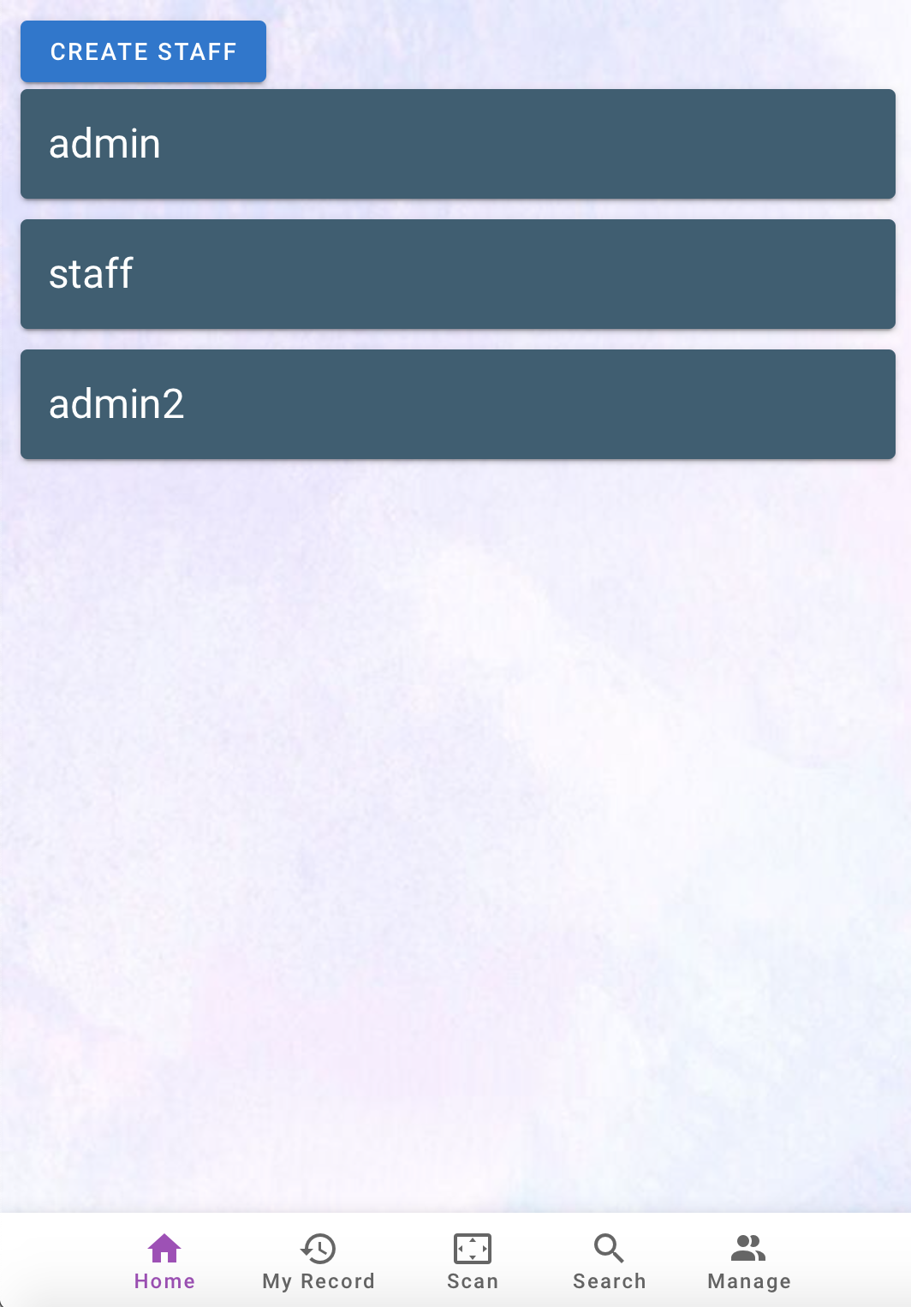
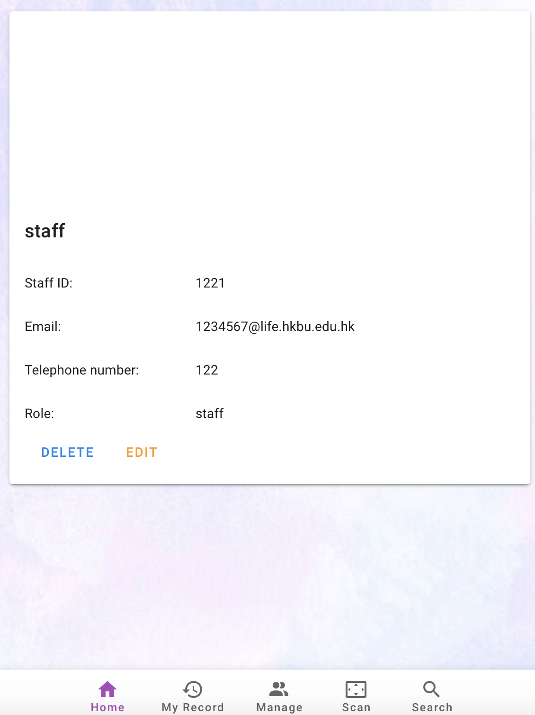

Staff List and Detail
Admin can find the staff list inside “staff edit”
Admin can create staff by pressing the top ‘Create Staff’ button
Staff list shows the username of all staff
Click on the name of staff, a detail page of that staff will be shown

Slide 22
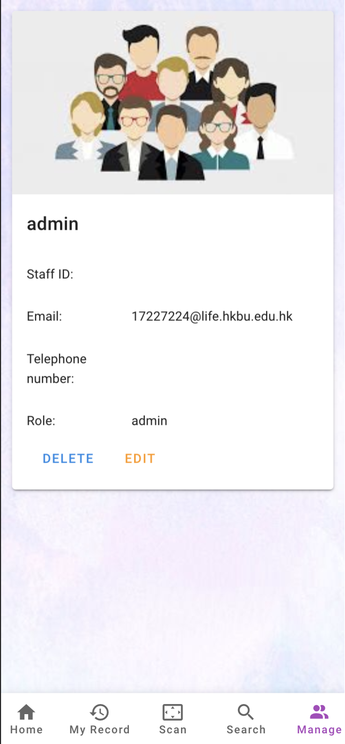
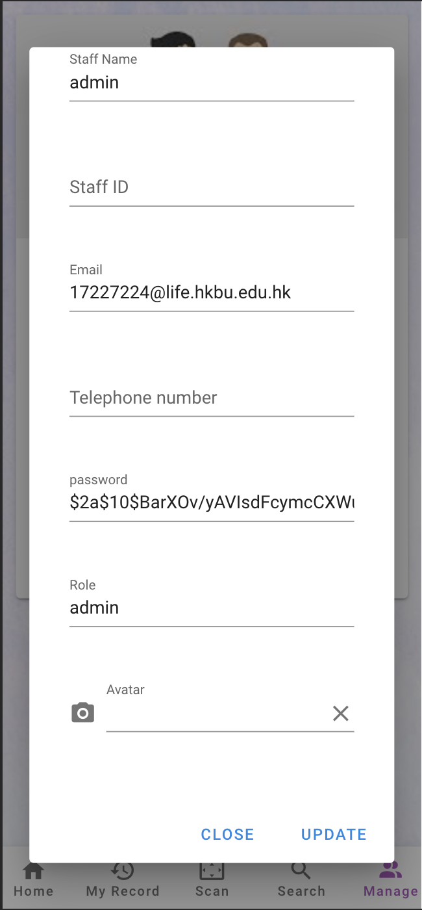
Staff Edit
Click the EDIT button in detail page, a form will be shown
Admin can change the information of each row
Click UPDATE button to update the information of the staff

Slide 23
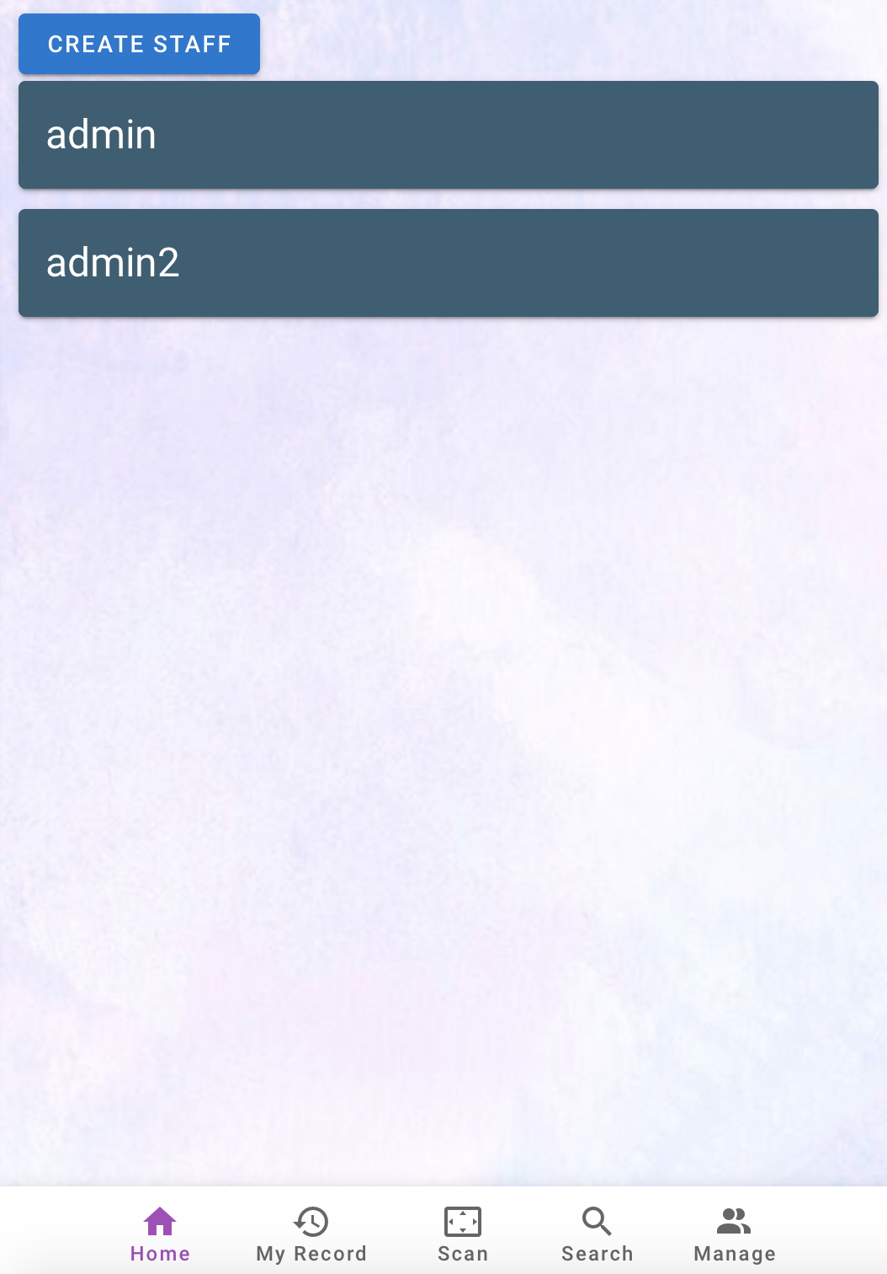
Staff Delete
Click the DELETE button in detail page, a delete message will be provided
Admin can delete the unwanted staff by clicking ‘Yes’ button
After delete, the page will redirect to the staff list
No
Yes

Slide 24
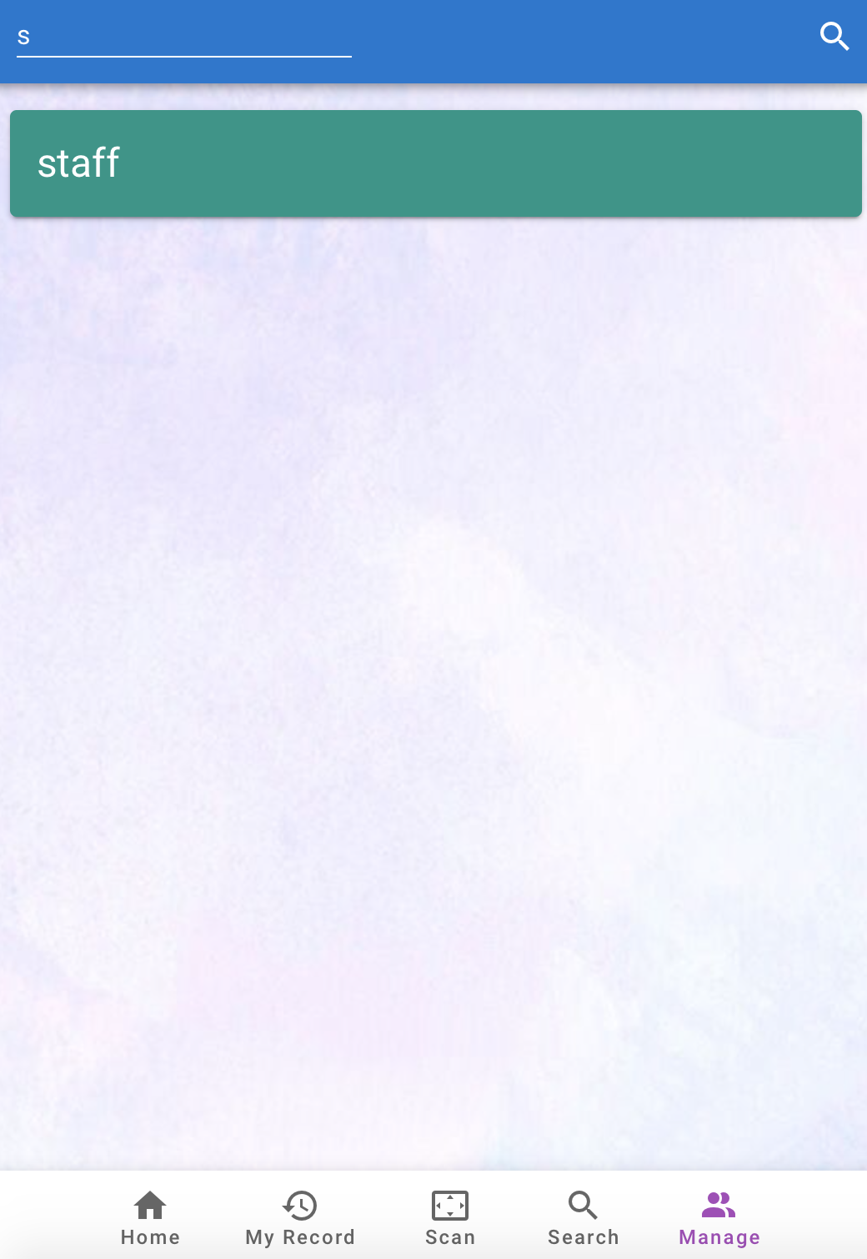
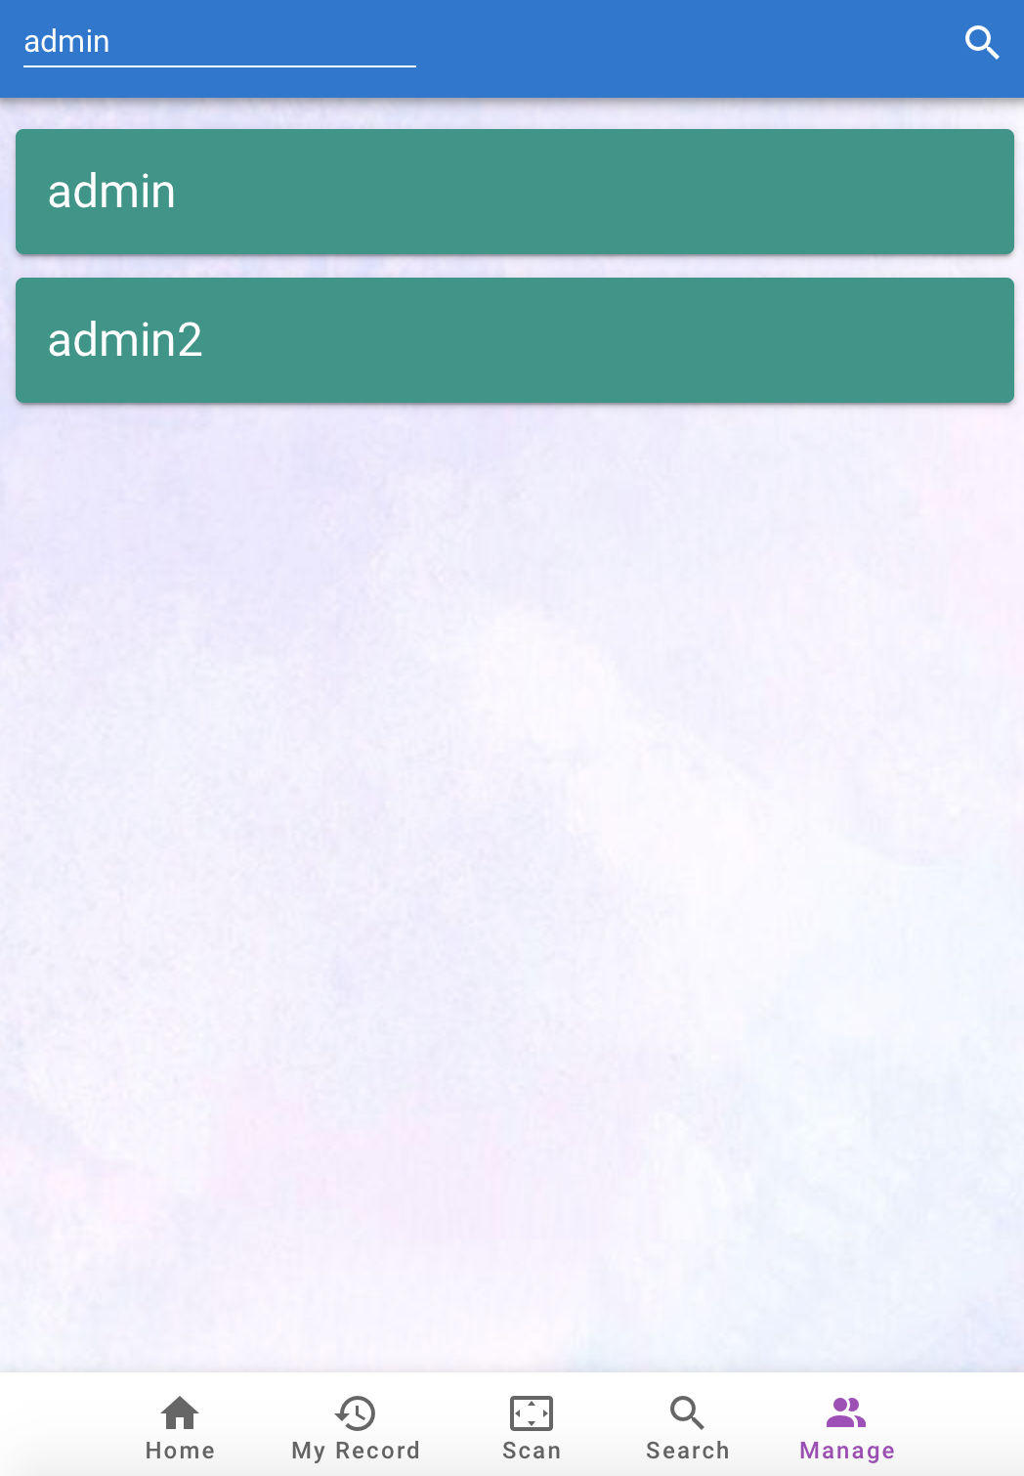
Staff Search
Admin is able to search different user in this page
Enter the keyword and the matched result will be listed out
By clicking the result is able to view and edit the staff detail

Slide 25
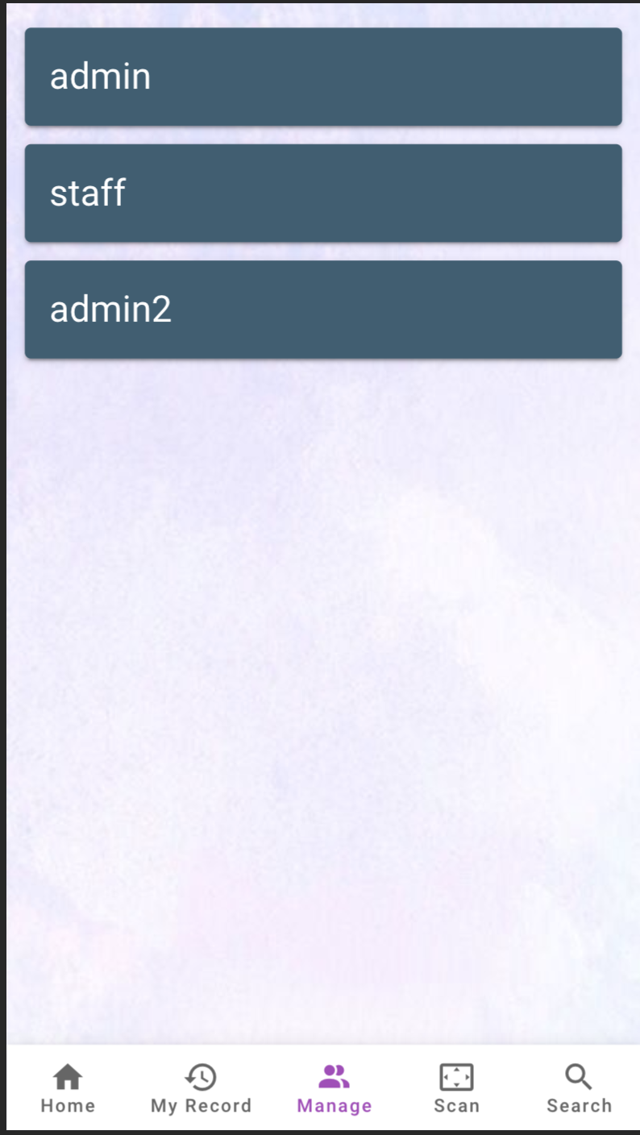
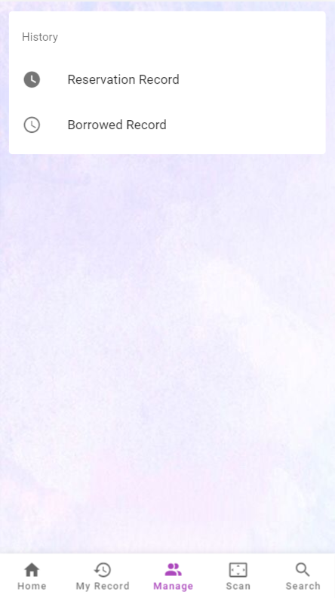
Staff Activity History
Admin can view the booking and borrow history of staff.
Admin can simply click on the staff’s name and a history page will be directed
The page will be directed after clicking booked record or borrowed record will be the same as activity history

Slide 26
Demonstration

